Slide 1


Deloitte
Case Study
DETAILED PROJECT REPORT

Slide 2
About
Project
This project focuses on leveraging Power BI to analyze the financial services sector, encompassing banks, insurance companies, and investment funds. It aims to uncover actionable insights by visualizing key data trends.

Slide 3

Objective
Overview
The objective is to utilize data visualization techniques to understand and analyze financial service operations. By applying Business Intelligence tools like Power BI, the project aims to deliver a clear, visual understanding of the data and identify growth opportunities.

Slide 4
Problem
Statement
The financial services industry requires an end-to-end understanding of transaction processes, customer interactions, products, services, and technology. This analysis includes economic indicators such as the Consumer Price Index (CPI), exchange rates, and exports, spanning various countries. The aim is to optimize these elements for improved efficiency and customer satisfaction.

Slide 5
Dataset
Information
CPI Data: Reflects inflation trends across multiple countries and periods, providing insights into economic stability.
Exchange Rate Data: Covers currency exchange rates, a critical metric for international financial transactions.
Exports Data: Details on goods traded internationally, indicating economic performance and market demand.

Slide 6
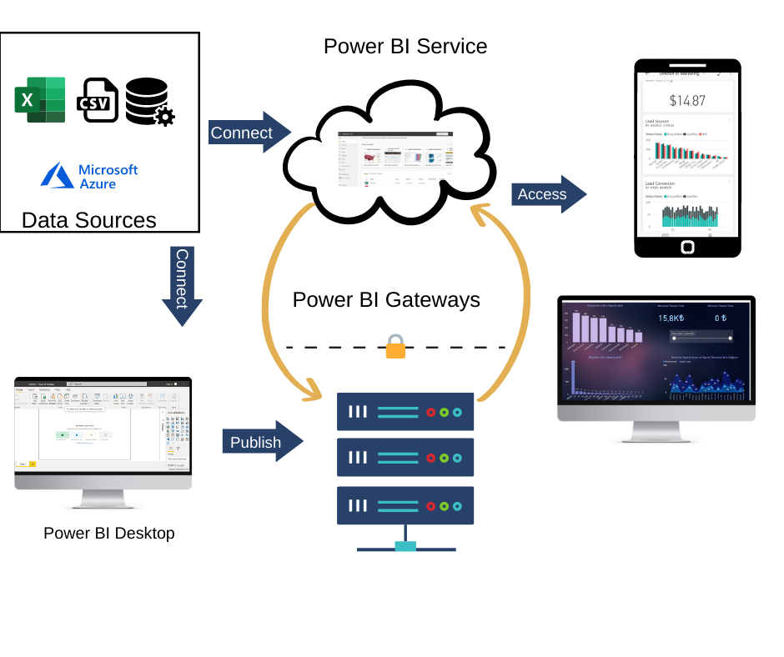
Architecture
The architecture integrates data preprocessing, modeling, and visualization in Power BI. Key steps include cleaning data, imputing missing values, and creating dynamic dashboards to highlight trends and insights.

Slide 7
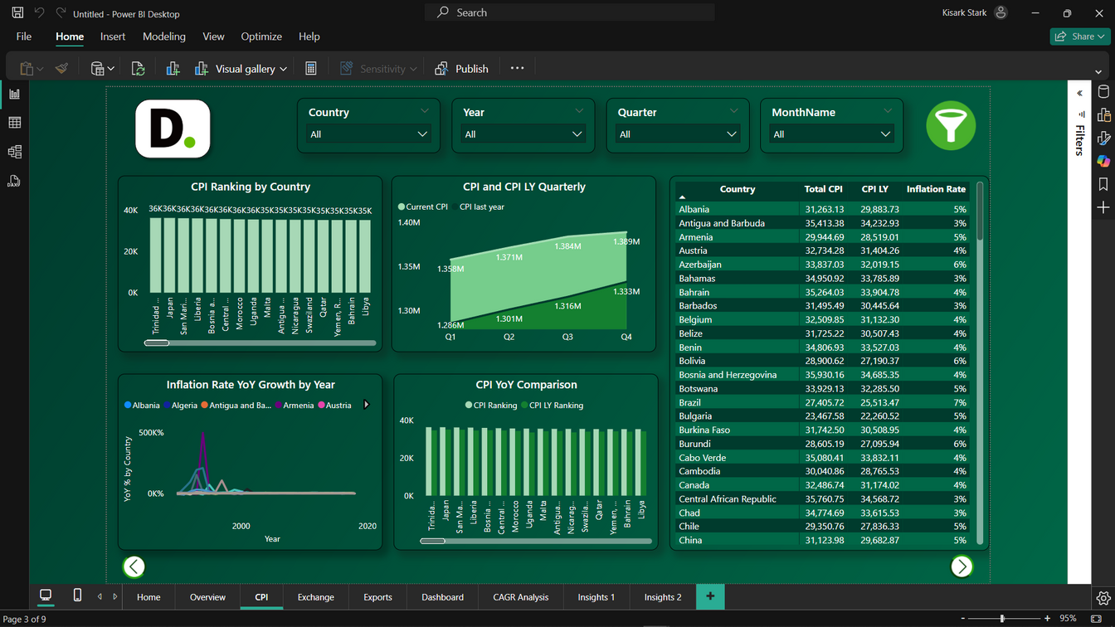
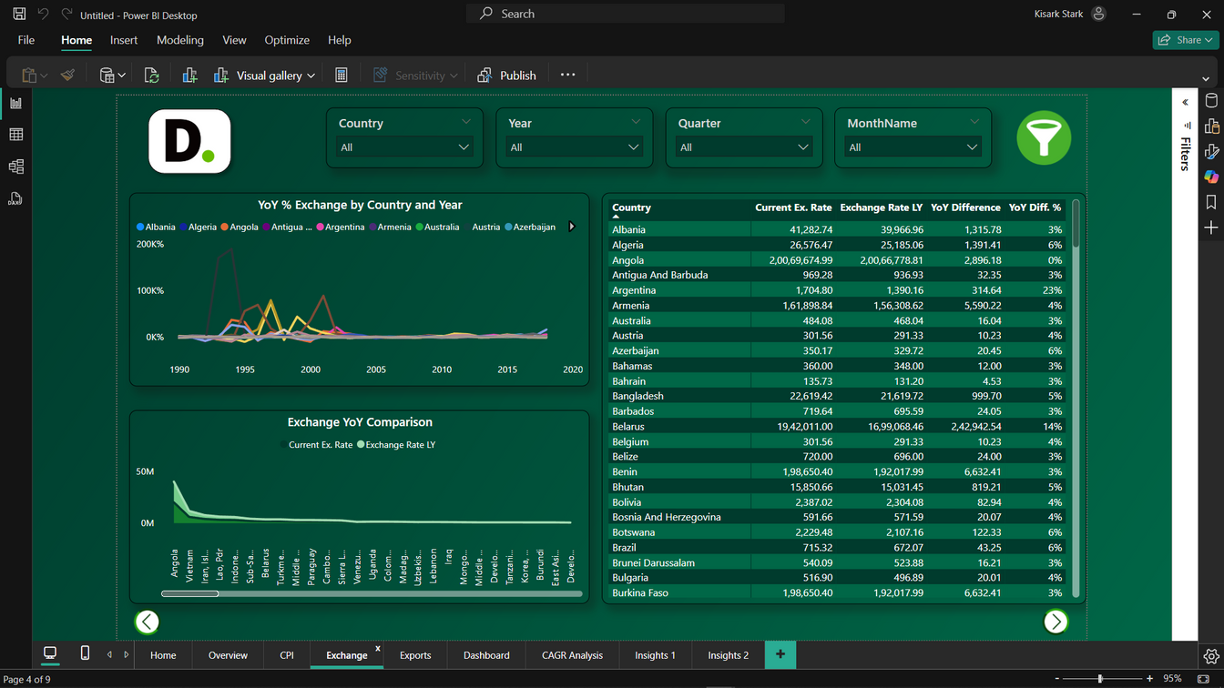
Insights
CPI Impact: Reveals inflation’s influence on purchasing power.
Exchange Rate Trends: Highlights currency fluctuations and trade implications.

Slide 8
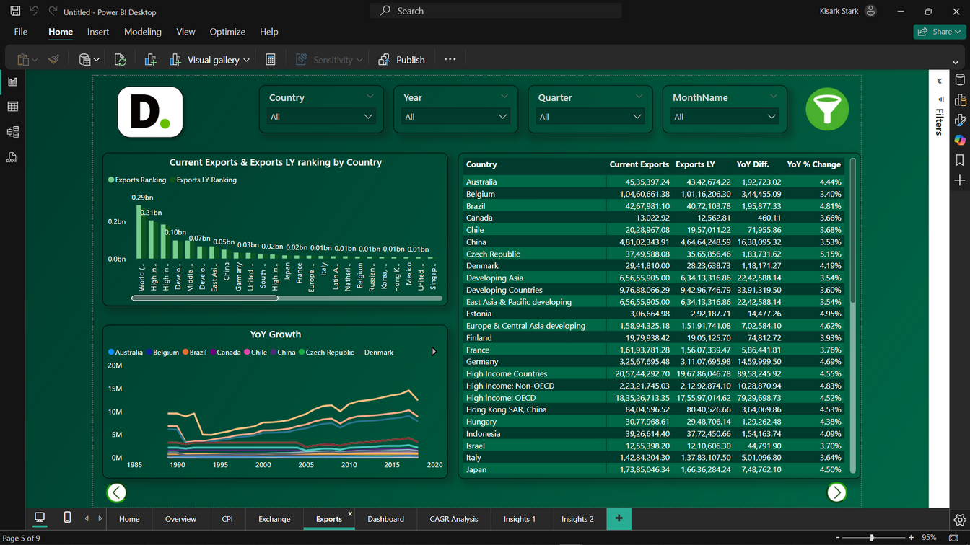
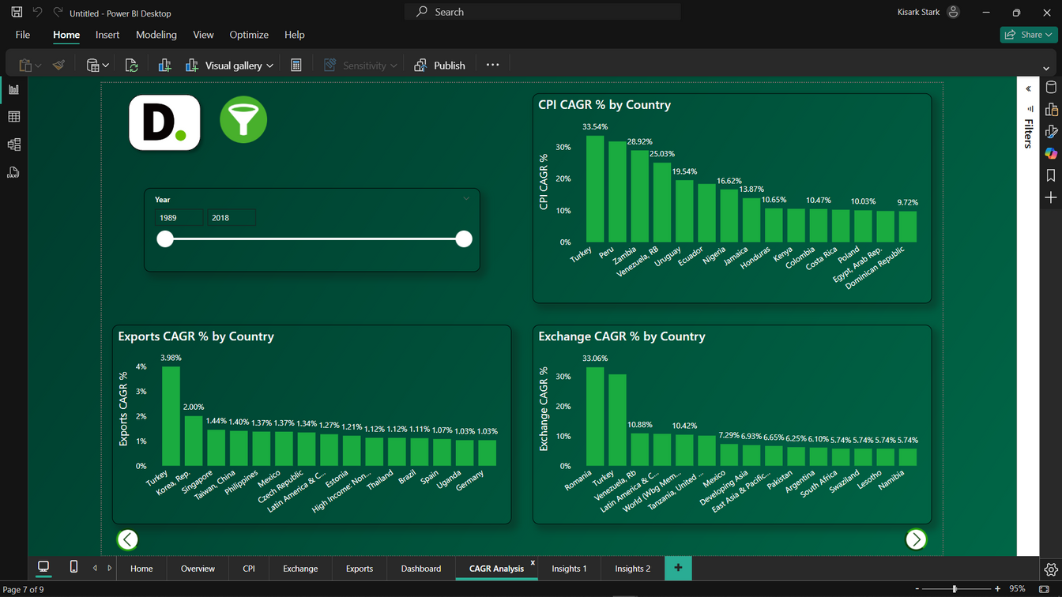
Insights
Export Performance: Shows economic reliance on global trade.
CAGR: CAGR is the average annual growth rate over a period, assuming constant growth.

Slide 9
KPIs
Key indicators displaying a summary of effect on different countries by CPI, EXCHANGE and EXPORTS rate
1. Impact of inflation of different countries.
2. Calculation of compound annual growth rate on different countries for different year (1998 to 2018).
3. Calculation of year of year growth rate on different countries for different year.
4. Impact of exchange rate on different countries for different year.
5. Impact of export rate on different countries for different year.

Slide 10
Questions
Q1: What’s the data source?
The data is sourced from global financial repositories, including The World Bank.
Q2: What types of data are analyzed?
A combination of numerical and categorical data.
Q3: What preprocessing techniques were applied?
Removing outliers, imputing missing values, and normalizing datasets.
Q4: What tools were used for analysis?
Power BI dashboards and visualizations for trend analysis and predictive insights.

Slide 11
Conclusion
Summary: The project delivers actionable insights into financial services by analyzing key economic indicators and customer trends.
Recommendations: Focus on digital transformation, optimize high-performing products, and leverage data analytics for strategic planning.
Outcome: Enhanced decision-making and operational efficiency in the financial sector.

Slide 12
Thank
You

